Slide 1
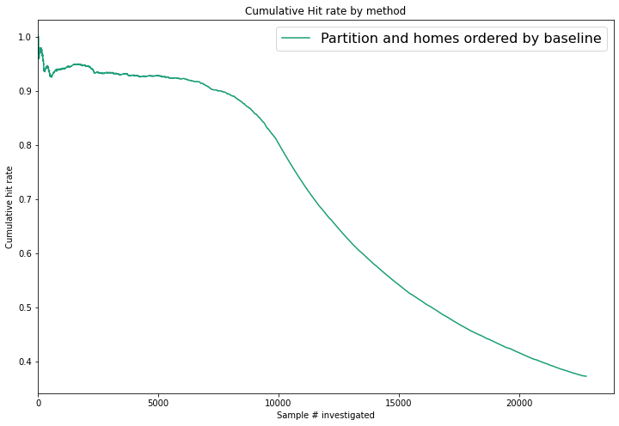
22 x 22 Partitioning

Slide 2
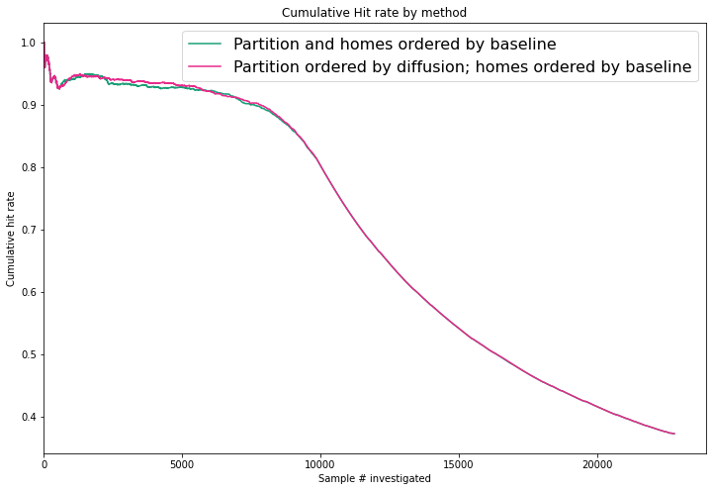
22 x 22 Partitioning

Slide 3
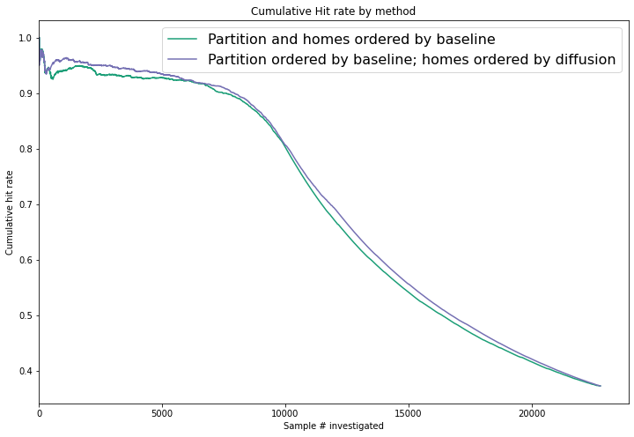
22 x 22 Partitioning

Slide 4
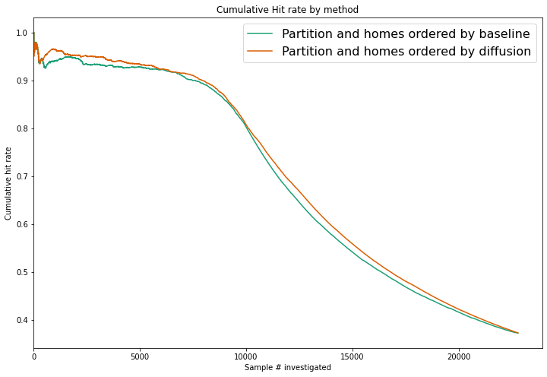
22 x 22 Partitioning

Slide 5
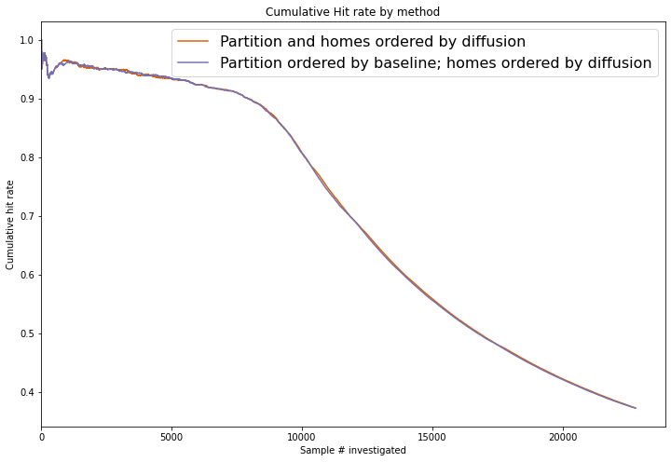
22 x 22 Partitioning

Slide 6
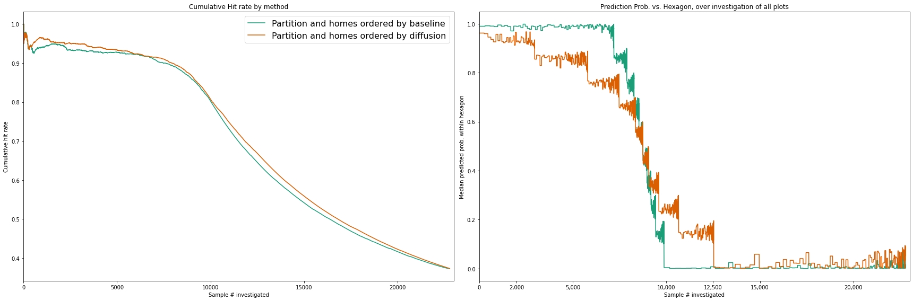
What is going on?

Slide 7
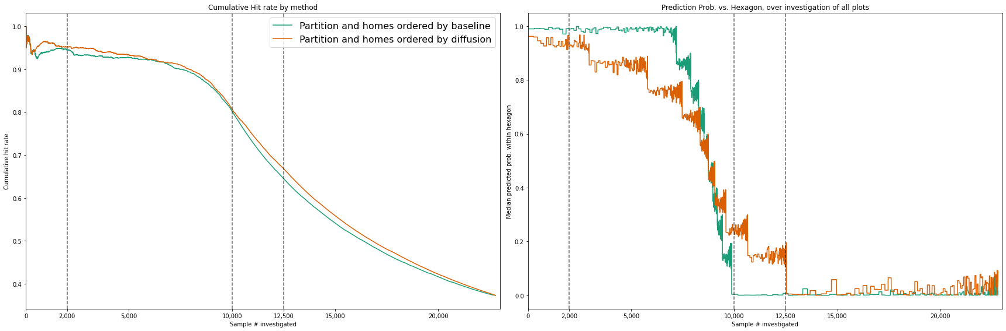
What is going on?

Slide 8
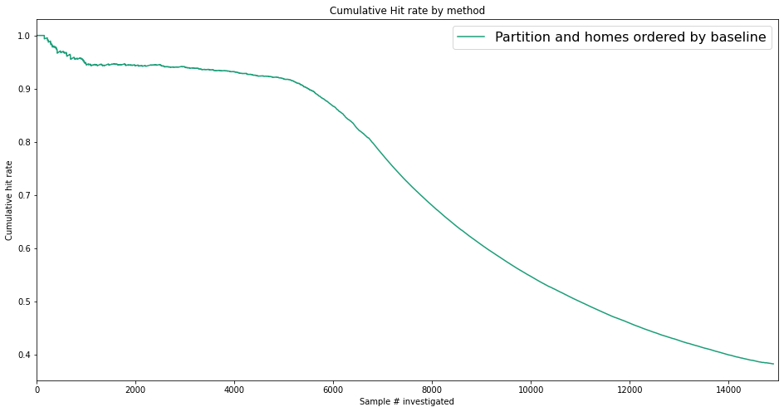
Hex Size = 99

Slide 9
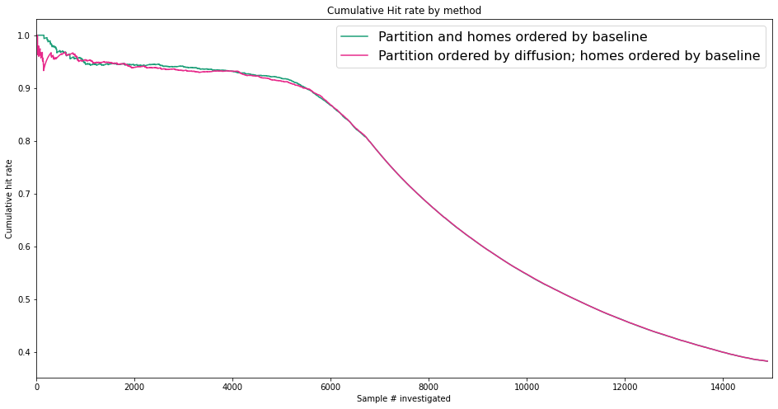
Hex Size = 99

Slide 10
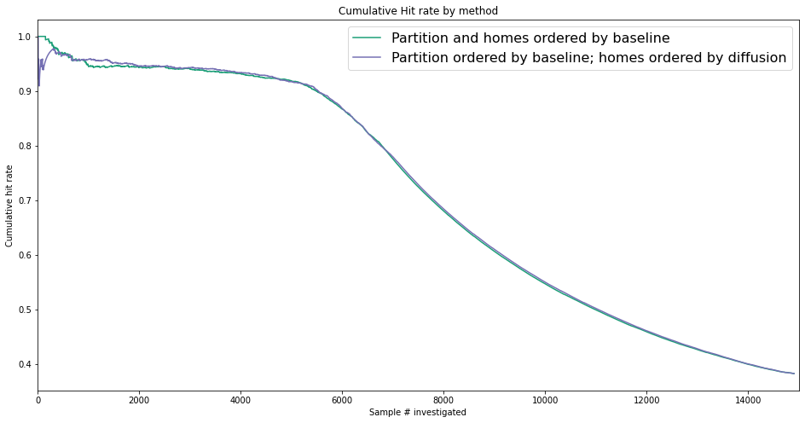
Hex Size = 99

Slide 11
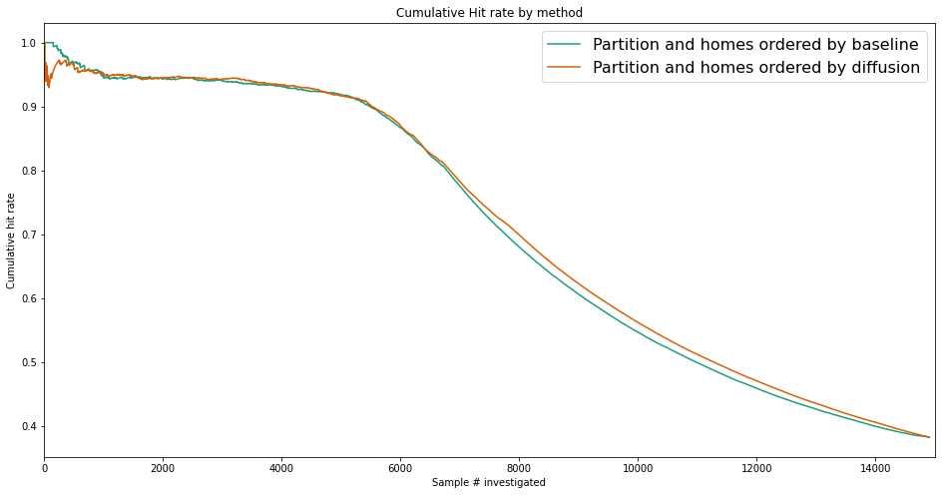
Hex Size = 99

Slide 12
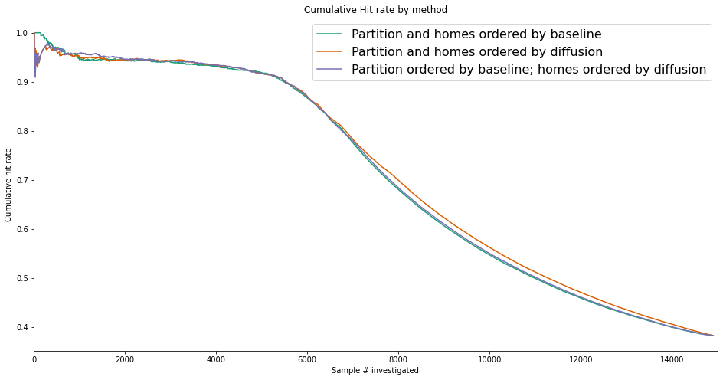
Hex Size = 99

Slide 13
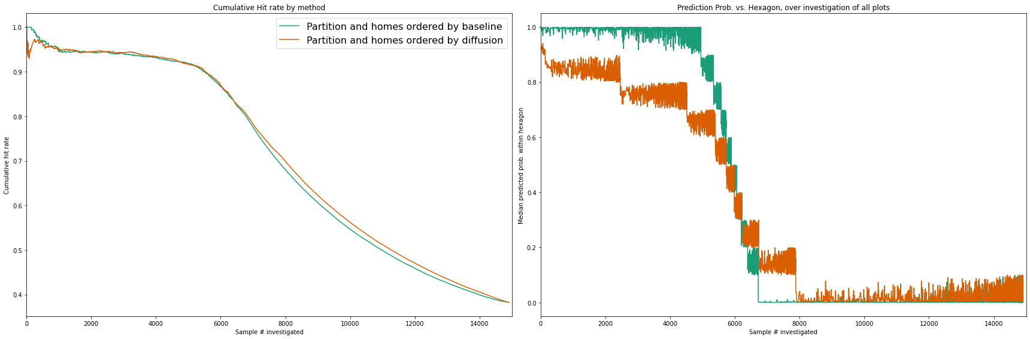
Hex Size = 99

Slide 14
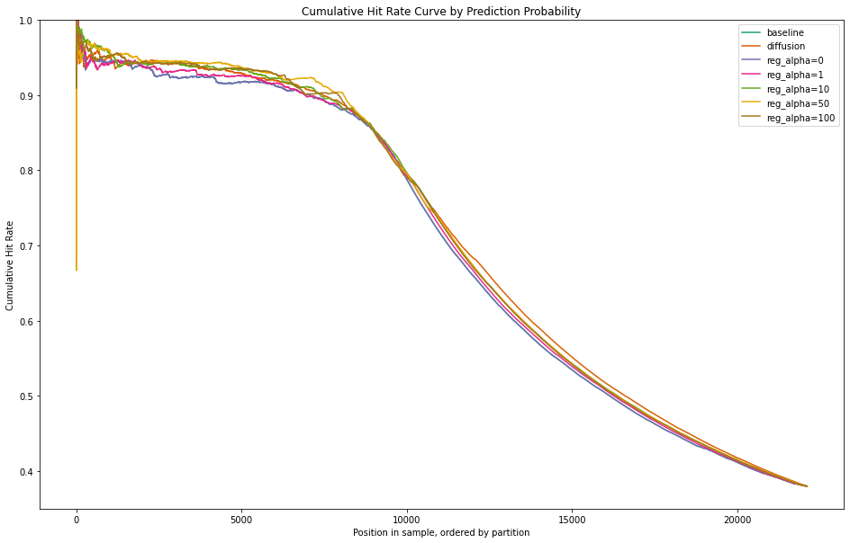
L1 Regularization (Alpha)

Slide 15
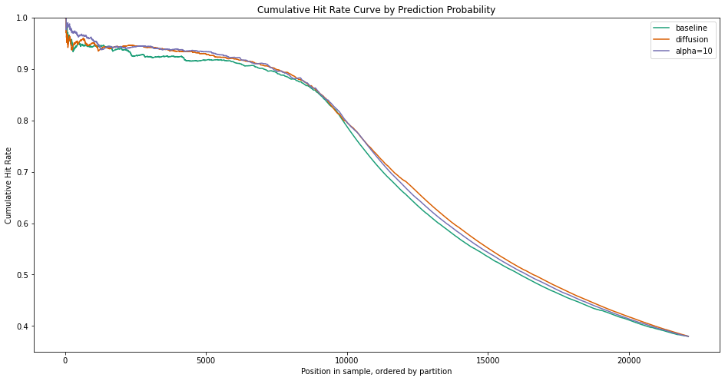
L1 Regularization (Alpha)

Slide 16
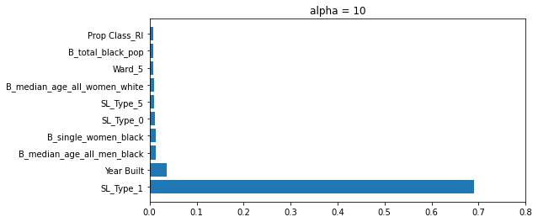
L1 Regularization (Alpha)

Slide 17
L1 Regularization (Alpha)

Slide 18
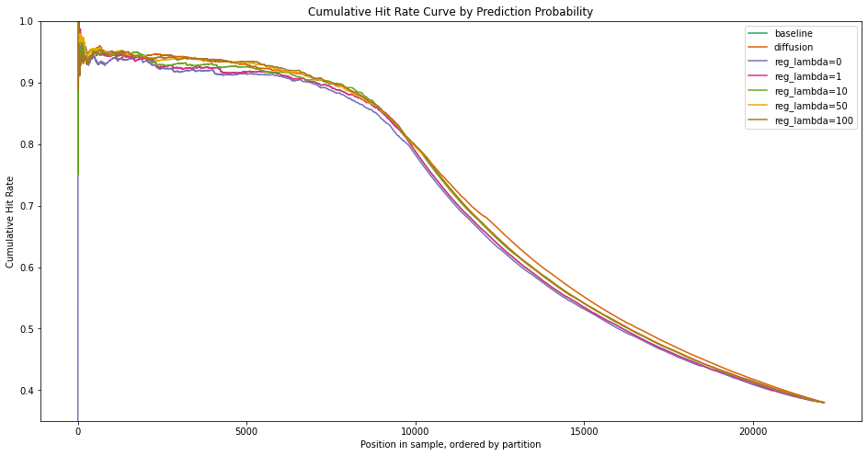
L2 Regularization (Lambda)

Slide 19
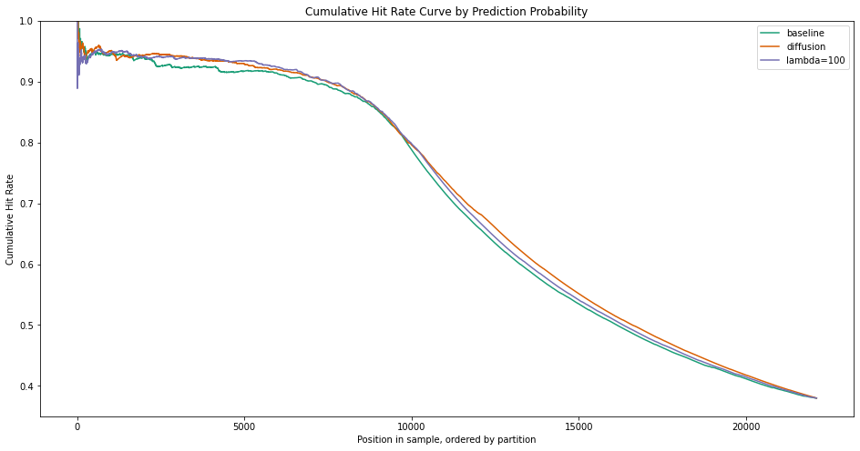
L2 Regularization (Lambda)

Slide 20
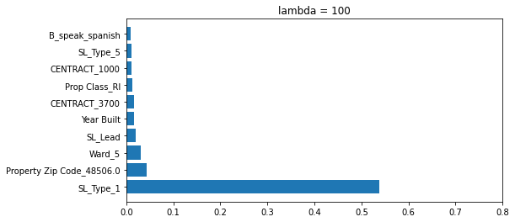
L2 Regularization (Lambda)

Slide 21
SL_Type_1

Slide 22
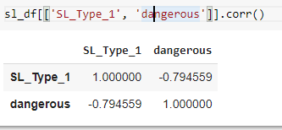
SL_Type_1

Slide 23
SL_Type_1

